Slide 1

Harvard University
DataFest 2017
Data Interactives with Tableau
Troy Adair, Senior Director, HBS Research Computing Services
18 January 2017

Slide 2
Introductions and Overview
Troy currently oversees Research Computing Services at Harvard Business School, but has previously managed reporting and analysis functions in both higher education and banking.
Specifically, have encountered and used Tableau as a dashboarding tool in both institutional research and business intelligence contexts.

Slide 3
What is a Dashboard?
Defn: a dashboard is a visual display of the most important information needed to achieve one or more objectives, consolidated and arranged on a single screen so the information can be monitored at a glance.
Key characteristics of a dashboard:
All the visualizations fit on a single computer screen — scrolling to see more violates the definition of a dashboard.
It shows the Key Performance Indicators (KPI) to be monitored, and these KPIs should be automatically updated without any assistance from the user. (I.e., “push” vs. “pull”)
Interactivity such as filtering and drill-down can be used in a dashboard, but should not be required to see which performance indicators are under performing.

Slide 4
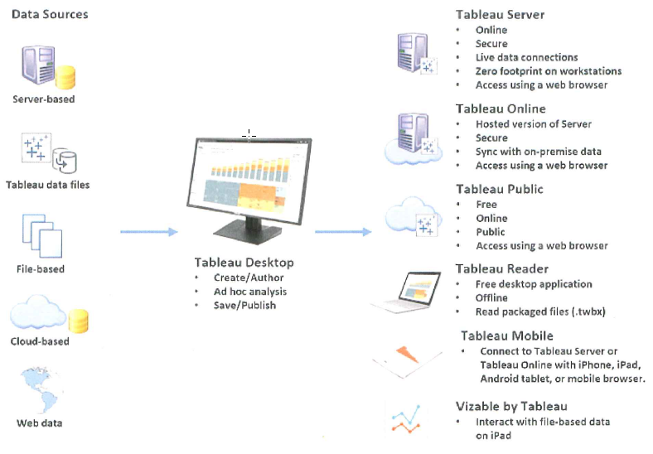
Tableau Product Line

Slide 5
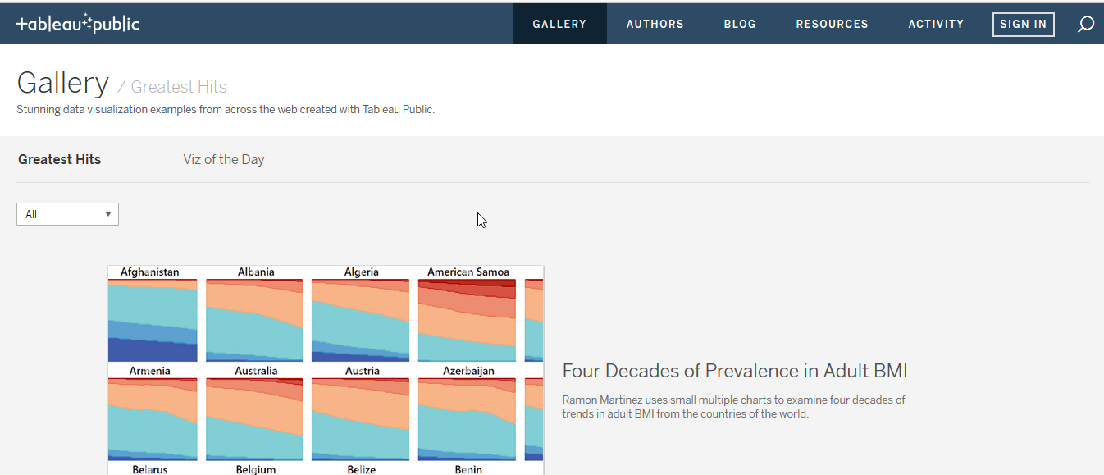
https://public.tableau.com/en-us/s/gallery

Slide 6
Today’s Objectives
Get you familiar with the Tableau Desktop
Overview of data connection setup and usage
Familiarization with terminology and concepts
Get started on using Tableau as a visualization tool

Slide 7
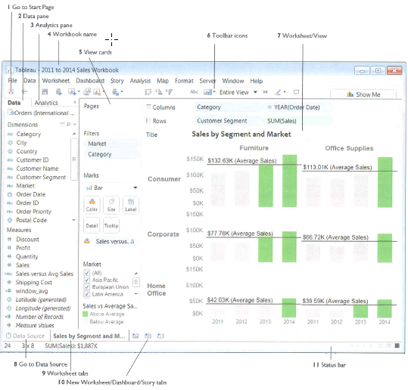
Tableau Terminology

Slide 8
…Let’s Go!

Slide 9
Thank You!

